Slide 1
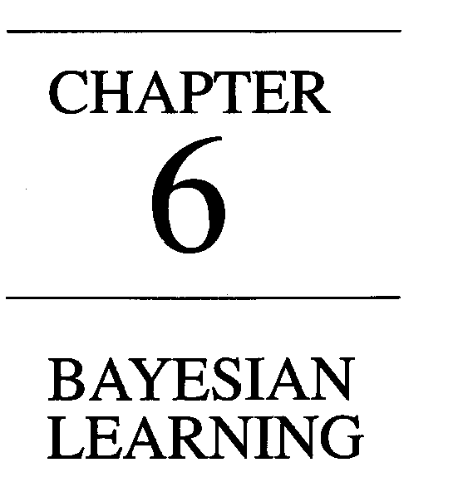
Bayesian Learning
B. Tech III Year
CS 601 PC
A srinivas
DS & AI Group (CSE) , KMIT, Hyderabad
March – June ,2021

Slide 2
6.1 | Bayesian Learning - Introduction
Bayesian reasoning provides a probabilistic approach to inference. It is based on the assumption that the quantities of interest are governed by probability distributions and that optimal decisions can be made by reasoning about these probabilities together with observed data.
It is important to machine learning because it provides a quantitative approach to weighing the evidence supporting alternative hypotheses.
Bayesian reasoning provides the basis for learning algorithms that directly manipulate probabilities, as well as a framework for analyzing the operation of other algorithms that do not explicitly manipulate probabilities

Slide 3

6.2 | BAYES THEOREM
Bayes theorem is the cornerstone of Bayesian learning methods because it provides a way to calculate the posterior probability P(h|D), from the prior probability P(h), together with P(D) and P(D(h).
As one might intuitively expect, P(h ID) increases with P(h) and with P(D|h) according to Bayes theorem. It is also reasonable to see that P(h|D) decreases as P(D) increases, because the more probable it is that D will be observed independent
of h, the less evidence D provides in support of h.

Slide 4
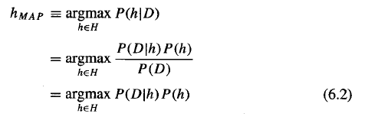
In many learning scenarios, the learner considers some set of candidate hypotheses H and is interested in finding the most probable hypothesis h ϵ H given the observed data D (or at least one of the maximally probable if there are several). Any such maximally probable hypothesis is called a maximum a posteriori (MAP) hypothesis. We can determine the MAP hypotheses by using
Bayes theorem to calculate the posterior probability of each candidate hypothesis.
More precisely, we will say that MAP is a MAP hypothesis provided

Slide 5
6.2.1 An Example
To illustrate Bayes rule, consider a medical diagnosis problem in which there are
two alternative hypotheses:
(1) that the patient has a particular form of cancer, and
(2) that the patient does not.
The available data is from a particular laboratory test with two possible outcomes:
We have prior knowledge that over the entire population of people only .008 have this disease.
Furthermore, the lab test is only an imperfect indicator of the disease. The test
returns a correct positive result in only 98% of the cases in which the disease is
actually present and a correct negative result in only 97% of the cases in which
the disease is not present. In other cases, the test returns the opposite result.

Slide 6


The above situation can be summarized by the following probabilities:
Suppose we now observe a new patient for whom the lab test returns a positive result. Should we diagnose the patient as having cancer or not? The maximum a posteriori hypothesis can be found using Equation (6.2):

Slide 7
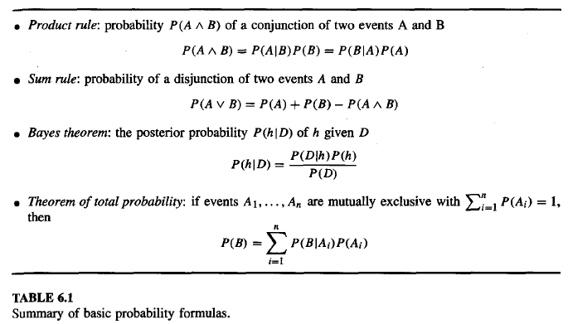
6.3 | BAYES THEOREM AND CONCEPT LEARNING
What is the relationship between Bayes theorem and the problem of concept learning?
Since Bayes theorem provides a principled way to calculate the posterior
probability of each hypothesis given the training data, we can use it as the basis
for a straightforward learning algorithm that calculates the probability for each
possible hypothesis, then outputs the most probable.

Slide 8
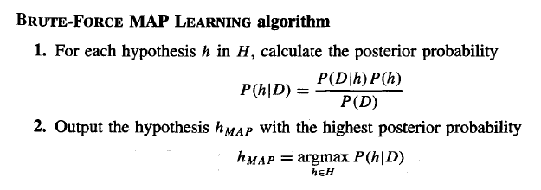
6.3.1 Brute-Force Bayes Concept Learning
In order specify a Iearning problem for the BRUTE-FORCE MAP LEARNING algorithm we must specify what values are to be used for P(h) and for P(D|h) (as we shall see, P(D) will be determined once we choose the other two). We may choose the probability distributions P(h) and P(D|h) in any way we wish, to describe our prior knowledge about the learning task. Here let us choose them
to be consistent with the following assumptions:

Slide 9
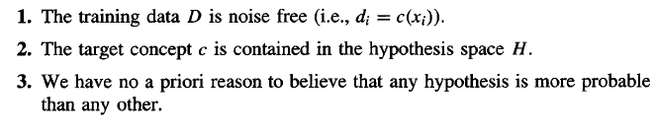
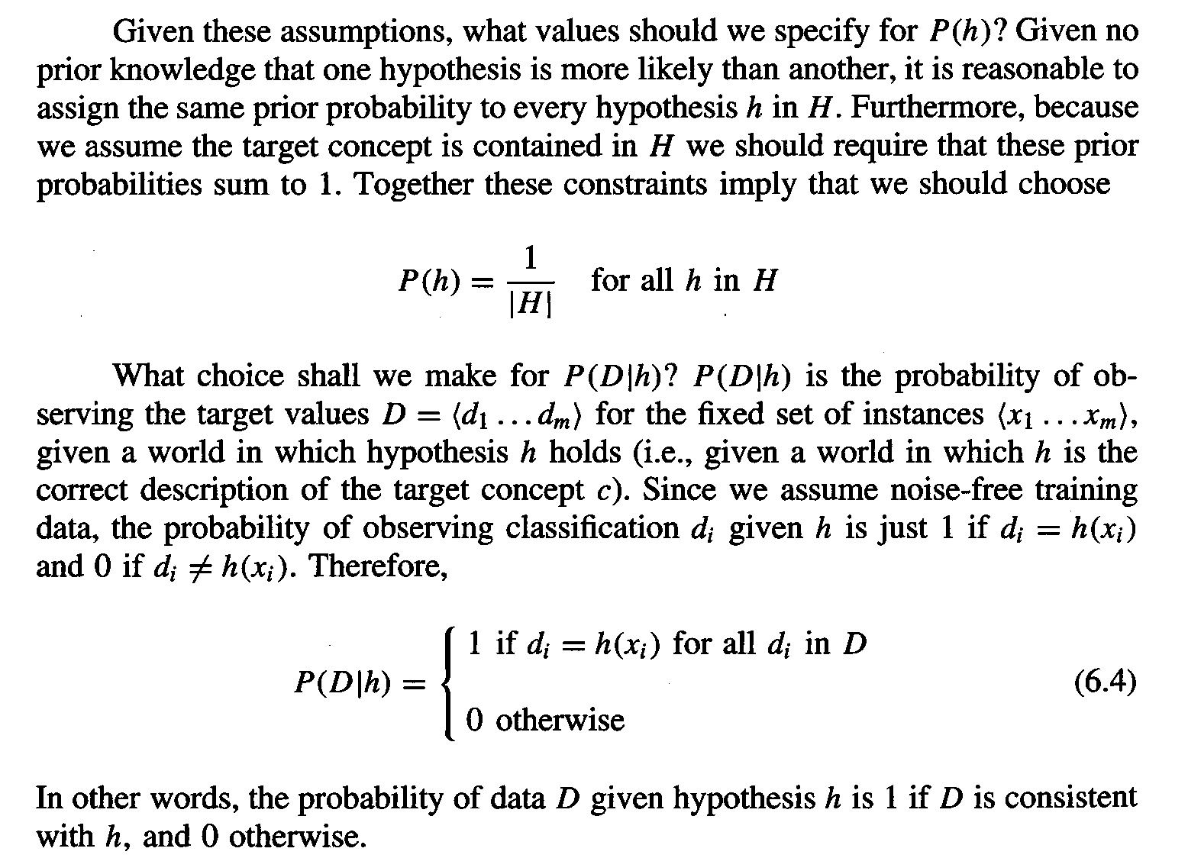

Slide 10
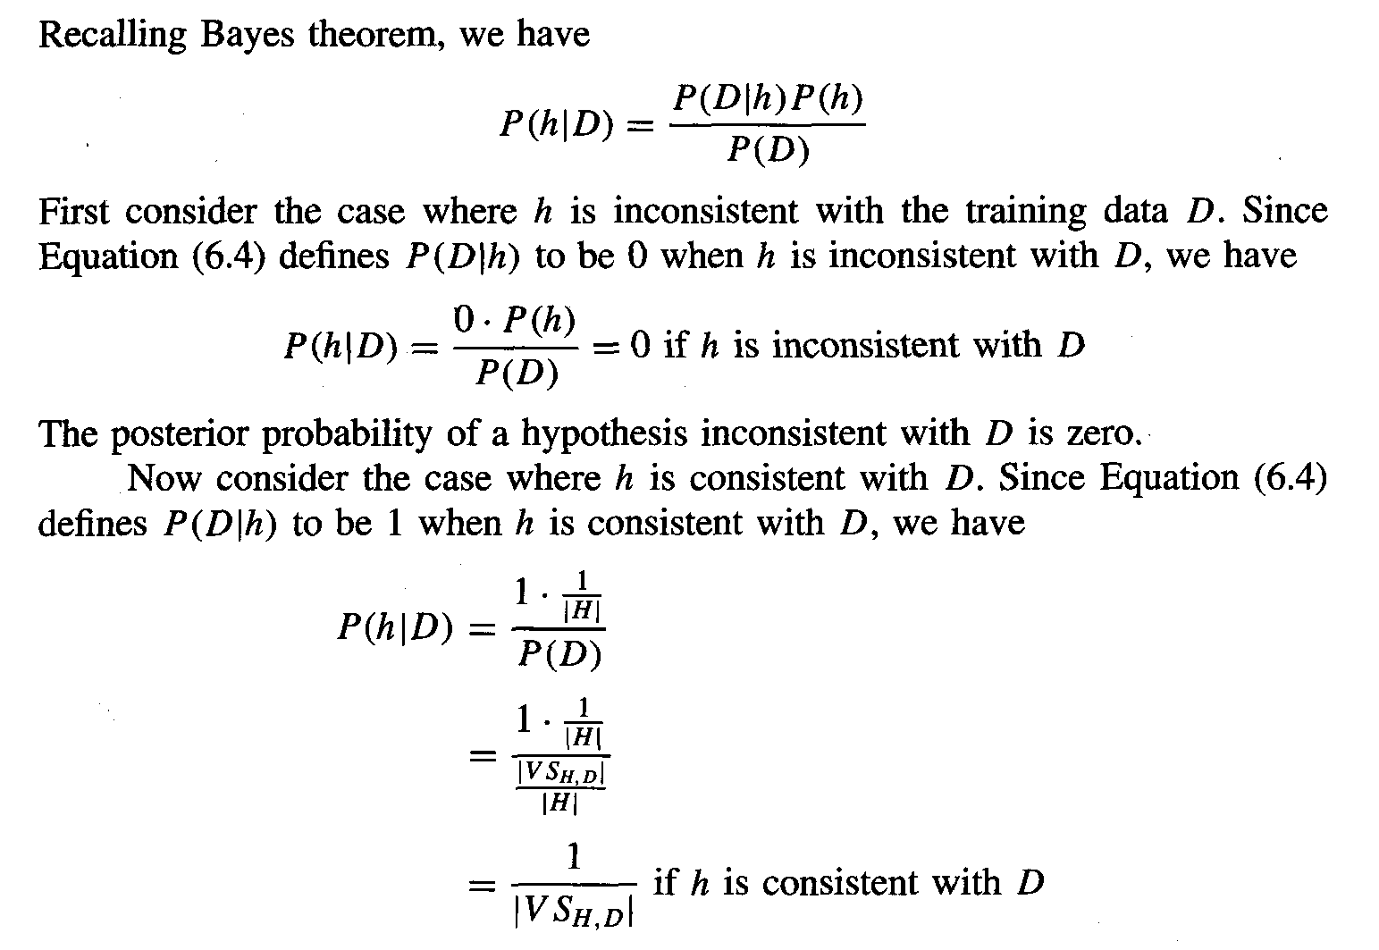

Slide 11
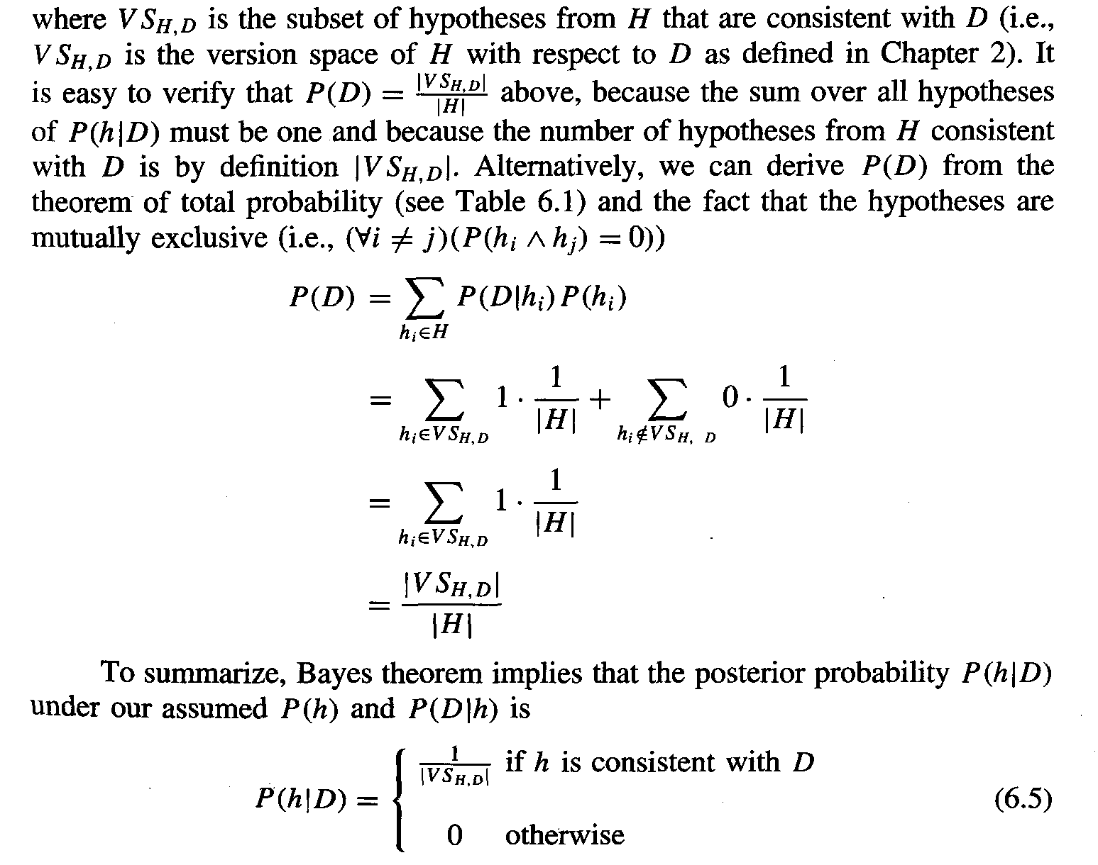

Slide 12
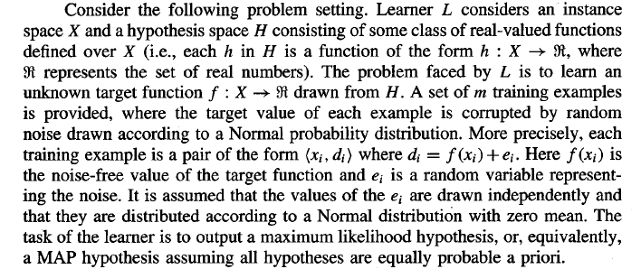
6.4 MAXIMUM LIKELIHOOD AND LEAST-SQUARED ERROR HYPOTHESES

Slide 13
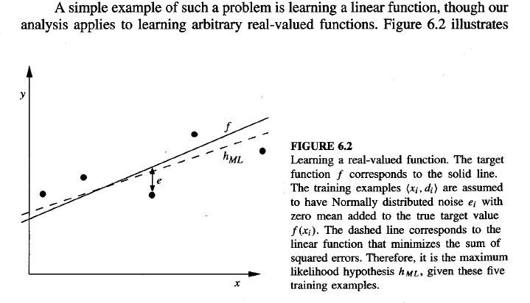

Slide 14
a linear target function f depicted by the solid line, and a set of noisy training examples of this target function. The dashed line corresponds to the hypothesis h_{ML} with least-squared training error, hence the maximum likelihood hypothesis.
Notice that the maximum likelihood hypothesis is not necessarily identical to the correct hypothesis, f, because it is inferred from only a limited sample of noisy training data.

Slide 15
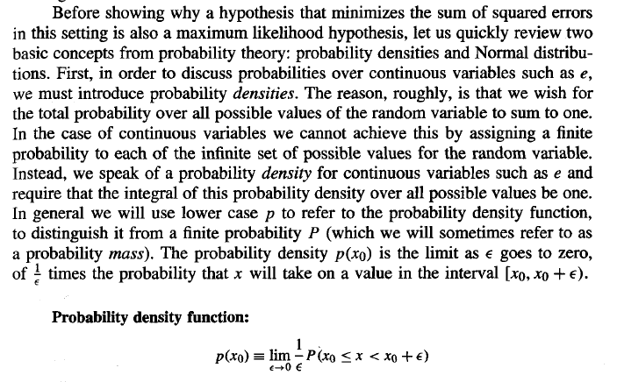

Slide 16
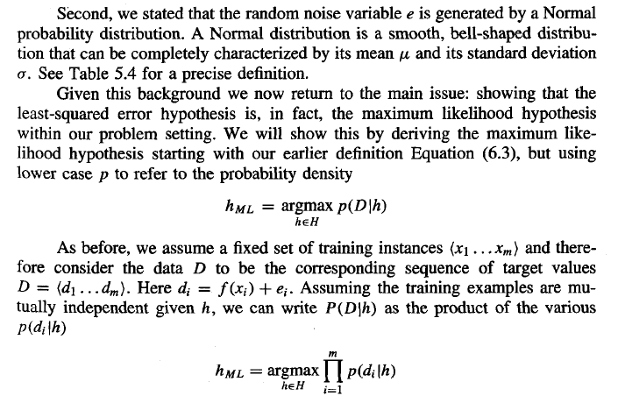

Slide 17
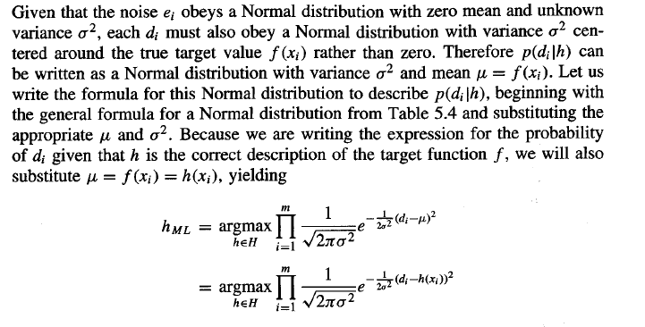

Slide 18
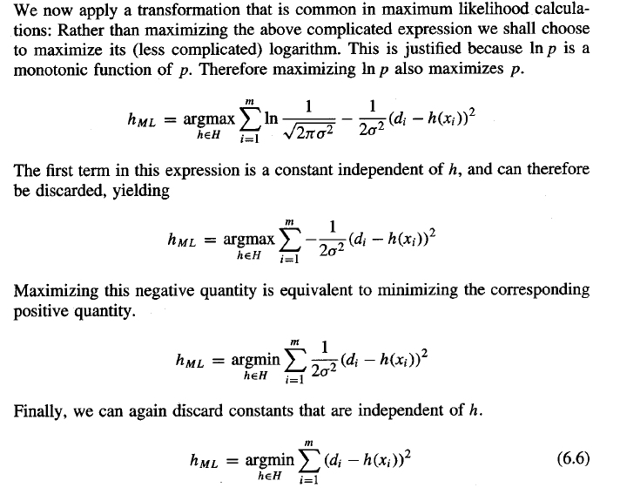

Slide 19
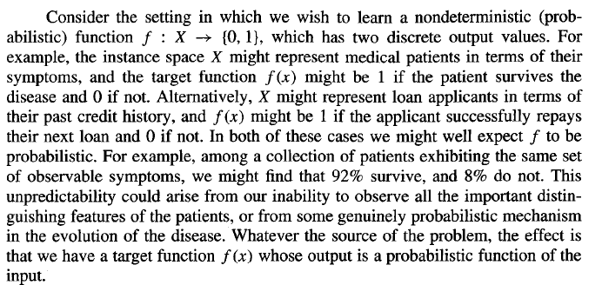
6.5 MAXIMUM LIKELIHOOD HYPOTHESES FOR PREDICTING PROBABILITIES

Slide 20
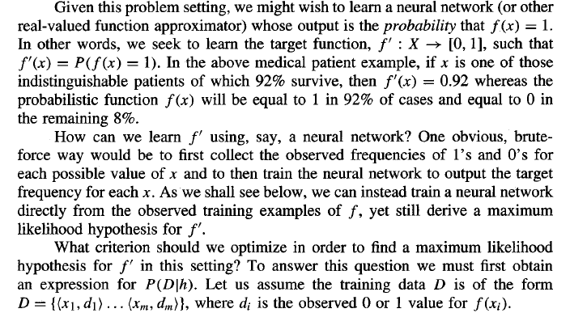

Slide 21
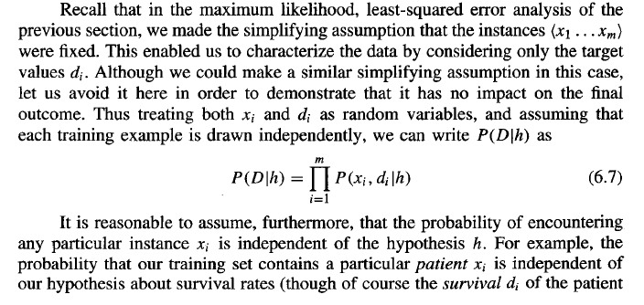

Slide 22
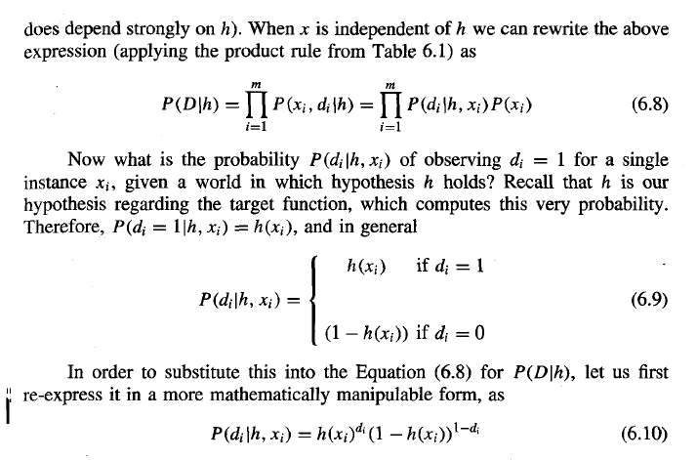

Slide 23
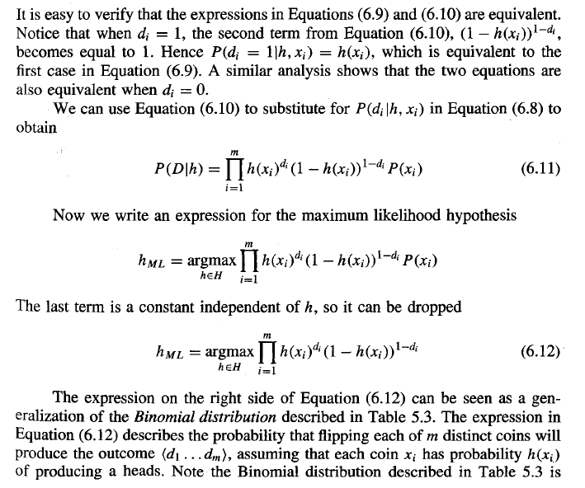

Slide 24
6.8 GIBBS ALGORITHM
Although the Bayes optimal classifier obtains the best performance that can be achieved from the given training data, it can be quite costly to apply. The expense is due to the fact that it computes the posterior probability for every hypothesis in H and then combines the predictions of each hypothesis to classify each new instance.
An alternative, less optimal method is the Gibbs algorithm , defined as follows:
Choose a hypothesis h from H at random, according to the
posterior probability distribution over H.
2. Use h to predict the classification of the next instance x.

Slide 25
Given a new instance to classify, the Gibbs algorithm simply applies a
hypothesis drawn at random according to the current posterior probability distribution. Surprisingly, it can be shown that under certain conditions the expected misclassification error for the Gibbs algorithm is at most twice the expected error of the Bayes optimal classifier . More precisely, the expected value is taken over target concepts drawn at random according to the prior probability distribution assumed by the learner. Under this condition, the expected value of the error of the Gibbs algorithm is at worst twice the expected value of the error of the Bayes optimal classifier.
This result has an interesting implication for the concept learning problem
described earlier. In particular, it implies that if the learner assumes a uniform prior over H, and if target concepts are in fact drawn from such a distribution when presented to the learner, then classifying the next instance according to a hypothesis drawn at random from the current version space (according to a uniform distribution), will have expected error at most twice that of the Bayes optimal classijier. Again, we have an example where a Bayesian analysis of a non-Bayesian algorithm yields insight into the performance of that algorithm.

Slide 26
6.9 NAIVE BAYES CLASSIFIER
One highly practical Bayesian learning method is the naive Bayes learner, often called the Naive Bayes classifier. In some domains its performance has been shown to be comparable to that of neural network and decision tree learning.
The naive Bayes classifier applies to learning tasks where each instance x is described by a conjunction of attribute values and where the target function f ( x ) can take on any value from some finite set V. A set of training examples of the target function is provided, and a new instance is presented, described by the
tuple of attribute values (a₁, a₂.. .a_{n}). The learner is asked to predict the target value, or classification, for this new instance.

Slide 27
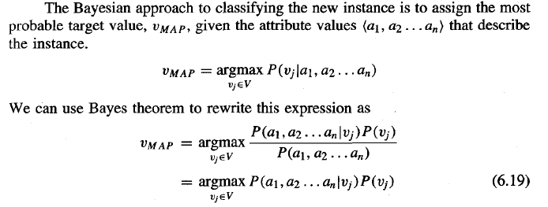
Now we could attempt to estimate the two terms in Equation (6.19) based on the training data. It is easy to estimate each of the P(v_{j}) simply by counting the frequency with which each target value vj occurs in the training data. However, estimating the different P(a₁, _{a2.}. . a_{n}) terms in this fashion is not feasible unless we have a very, very large set of training data. The problem is that the number of these terms is equal to the number of possible instances times the number of possible target values. Therefore, we need to see every instance in the instance space many times in order to obtain reliable estimates

Slide 28
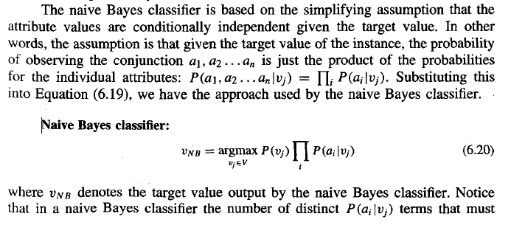

Slide 29
be estimated from the training data is just the number of distinct attribute values
times the number of distinct target values-a much smaller number than if we
were to estimate the P(a1, a2 . . . an lvj) terms as first contemplated.
To summarize, the naive Bayes learning method involves a learning step in
which the various P(vj) and P(ai Jvj) terms are estimated, based on their frequencies
over the training data. The set of these estimates corresponds to the learned
hypothesis. This hypothesis is then used to classify each new instance by applying
the rule in Equation (6.20). Whenever the naive Bayes assumption of conditional
independence is satisfied, this naive Bayes classification VNB is identical to the
MAP classification.
One interesting difference between the naive Bayes learning method and
other learning methods we have considered is that there is no explicit search
through the space of possible hypotheses (in this case, the space of possible
hypotheses is the space of possible values that can be assigned to the various P(vj)
and P(ailvj) terms). Instead, the hypothesis is formed without searching, simply by
counting the frequency of various data combinations within the training examples.

Slide 30
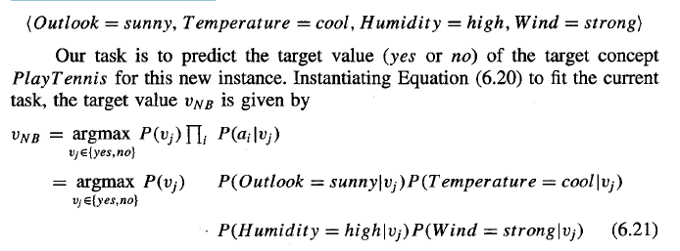
6.9.1 An Illustrative Example
Let us apply the naive Bayes classifier to a concept learning problem we considered
during our discussion of decision tree learning: classifying days according
to whether someone will play tennis. Table 3.2 from Chapter 3 provides a set
of 14 training examples of the target concept PlayTennis, where each day is
described by the attributes Outlook, Temperature, Humidity, and Wind. Here we
use the naive Bayes classifier and the training data from this table to classify the
following novel instance:

Slide 31
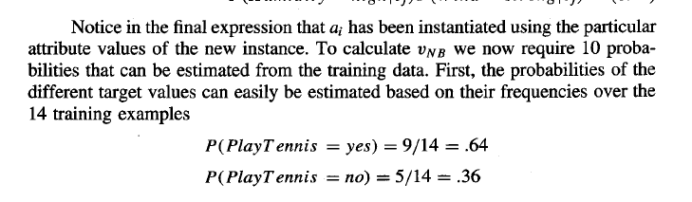
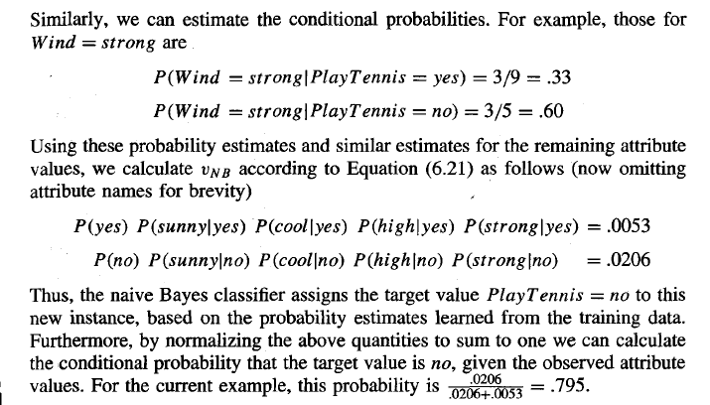

Slide 32
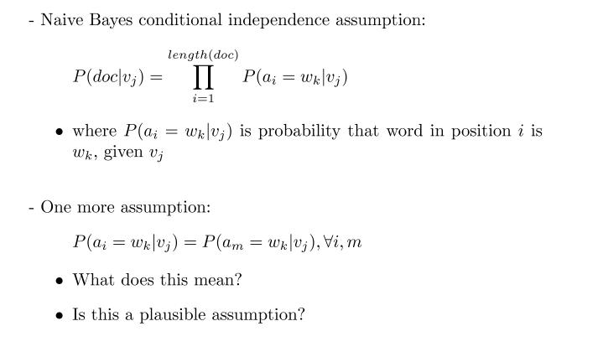
6.10 AN EXAMPLE: LEARNING TO CLASSIFY TEXT

Slide 33
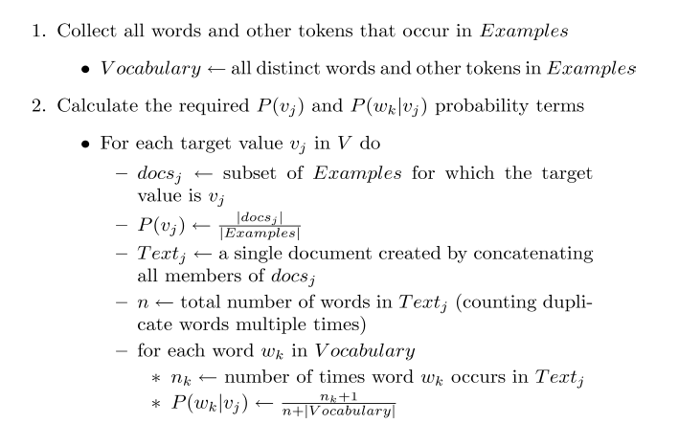

Slide 34
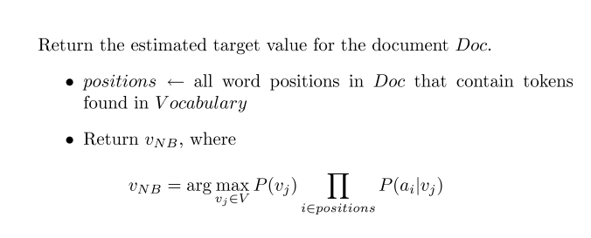

Slide 35
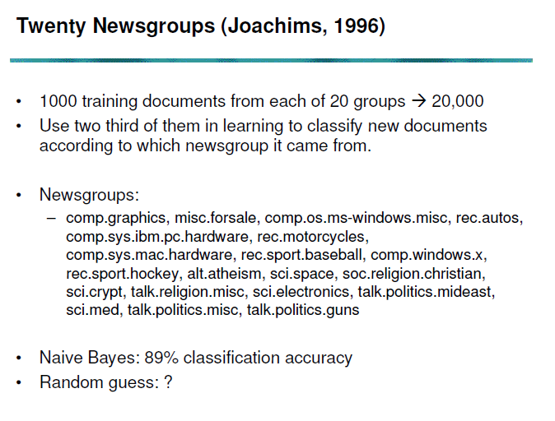

Slide 36
